Slide 1


Customer Churn Prediction Project
An end-to-end machine learning project to predict customer churn using Python, scikit-learn, and MySQL.
Capstone Project Trainer: Mr. Arun K.G.
By : Aruba Sood

Slide 2


Project Overview
01
02
03
Data Loading & Database Integration
Data Cleaning & Preprocessing
Exploratory Data Analysis (EDA)
Clean and preprocess data, handling duplicates, missing values, and outliers.
Perform EDA to understand data distributions and correlations, saving visualizations.
Load raw data from CSV and integrate with MySQL database for storage and retrieval.
04
05
Feature Engineering
Model Training & Evaluation
Apply one-hot encoding and feature scaling to prepare data for model training.
Train and evaluate multiple machine learning models for churn prediction.

Slide 3

Data Loading & Database Integration
Key Activities
Code Snippet
Load raw CSV data into a Pandas DataFrame.
from database.mysqldb import connect_db, display_all_customersfrom scripts.data_loader import load_csv_dataif __name__ == "__main__": file_path = "data/raw/exl_credit_card_churn_data.csv" connect_db() display_all_customers() df = load_csv_data(file_path)
Connect to MySQL database.
Insert data from CSV into the 'customers' table.
Display all customer records from the database.

Slide 4
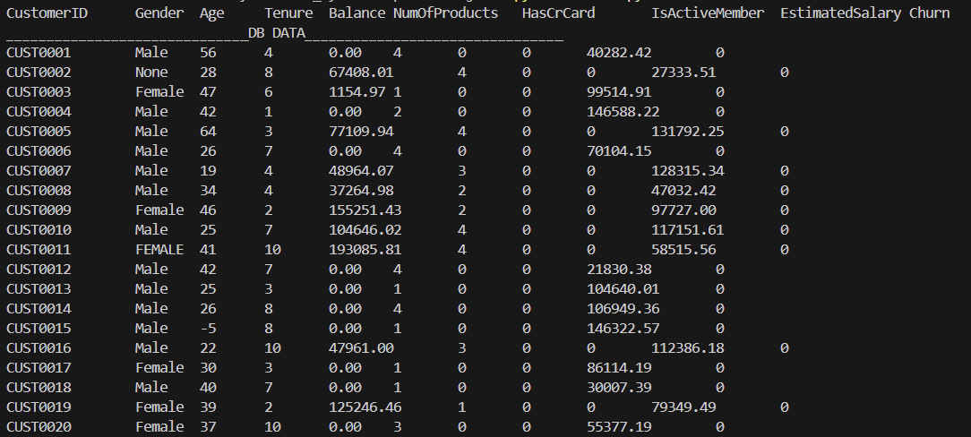
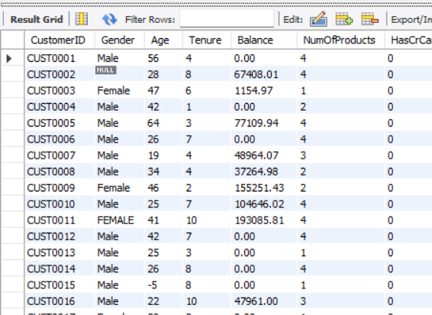

Slide 5

Data Cleaning & Preprocessing
The cleaning process involves several critical steps to ensure data quality and model readiness:
Duplicate Removal: Eliminating redundant entries to prevent bias.
Whitespace Stripping: Cleaning string columns for consistency.
Invalid Value Handling: Filtering out incorrect binary values and normalizing 'Gender' and 'Churn' labels.
Numerical Conversion: Converting relevant columns to numeric types and handling 'coerce' errors.
Missing Value Imputation: Dropping rows with any remaining missing values.
Outlier Removal: Using the IQR method to identify and remove outliers in numerical features.

Slide 6
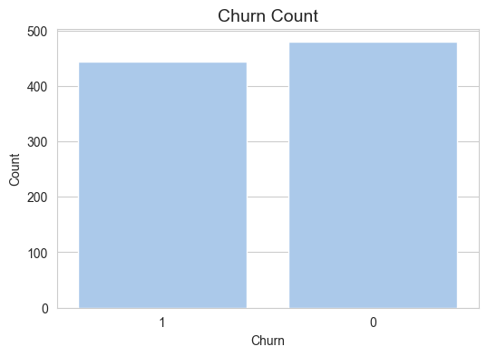
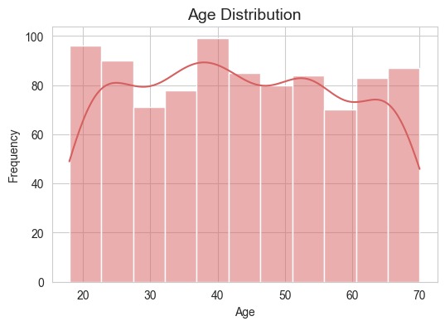
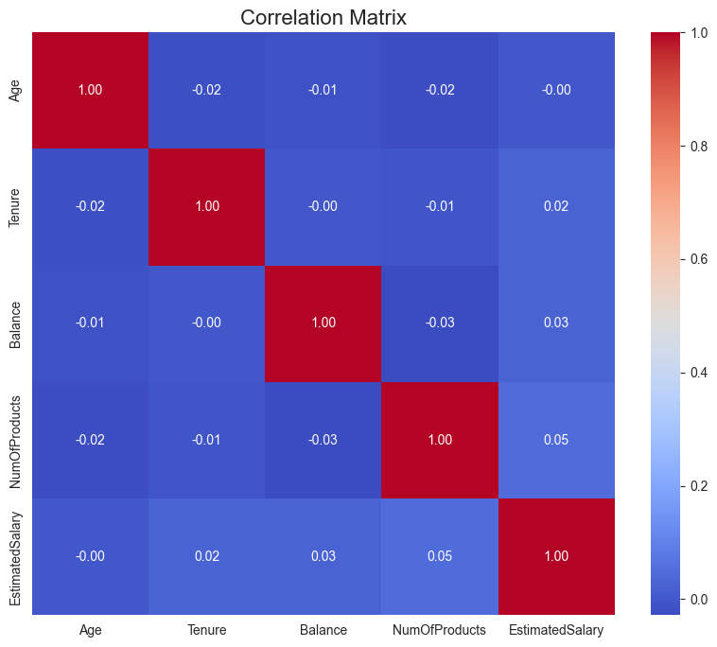
Exploratory Data Analysis (EDA)
EDA helps us understand the dataset's characteristics and uncover insights through visualizations.
Plots generated include churn distribution, age distribution, and a correlation matrix of numerical features.

Slide 7

Feature Engineering
One-Hot Encoding
Feature Scaling
Categorical features like 'Gender' are converted into a numerical format using one-hot encoding, making them suitable for machine learning models.
Numerical features are scaled using MinMaxScaler to normalize their range, preventing features with larger values from dominating the model training process.
def one_hot_encode(df: pd.DataFrame) -> pd.DataFrame: return pd.get_dummies(df, columns=['Gender'], drop_first=True)
from sklearn.preprocessing import MinMaxScalerdef scale_features(df: pd.DataFrame, numerical_cols: list) -> pd.DataFrame: scaler = MinMaxScaler() df[numerical_cols] = scaler.fit_transform(df[numerical_cols]) return df

Slide 8
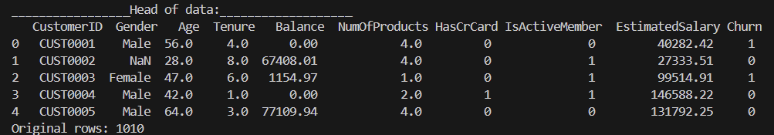
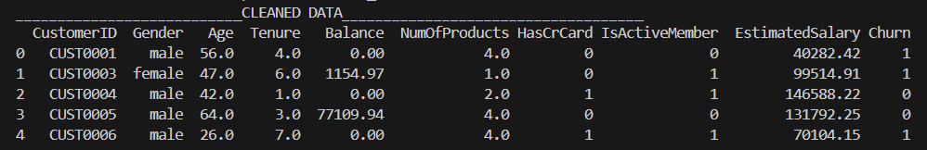
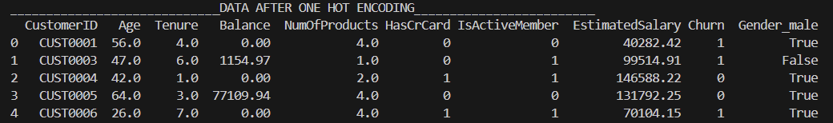
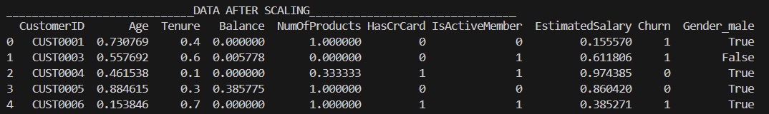
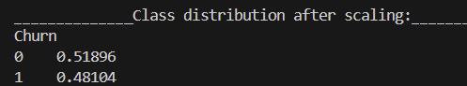

Slide 9



Model Training & Evaluation
We train and evaluate three different machine learning models to predict customer churn.
Random Forest Classifier
Logistic Regression
K-Nearest Neighbors (KNN)
An ensemble learning method for classification.
A linear model for binary classification.
A non-parametric, instance-based learning algorithm.
Models are saved, and performance metrics (classification report, confusion matrix) are generated for each.

Slide 10
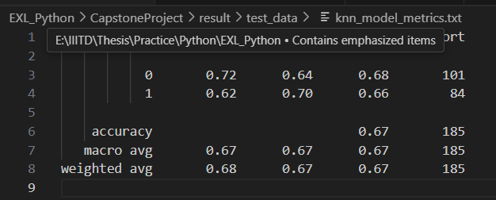
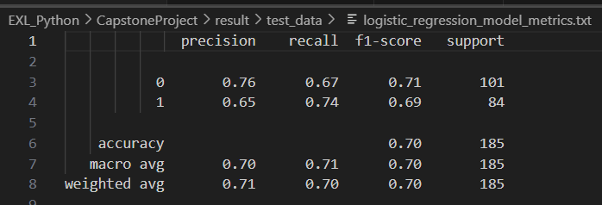
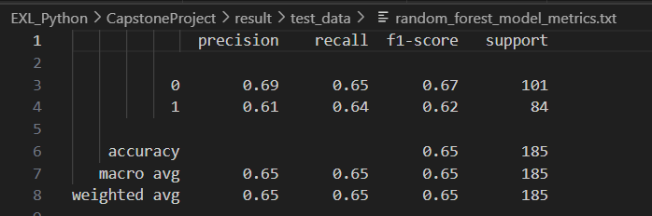
Classification Report

Slide 11
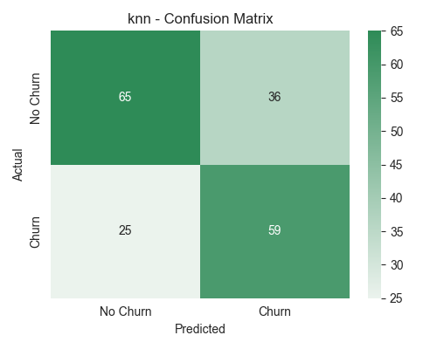
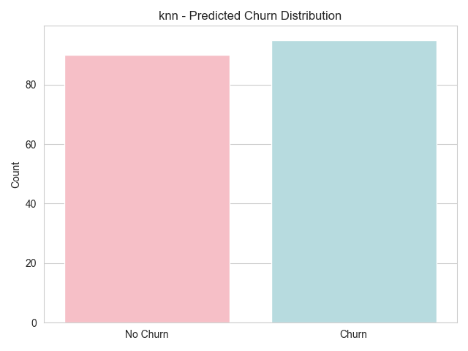
Model Evaluation Visualizations
Visualizations provide a clear understanding of model performance.
Each model's confusion matrix and predicted churn distribution are plotted and saved.
1) KNN

Slide 12
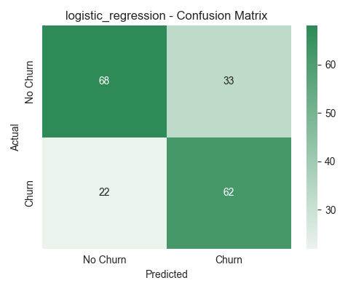
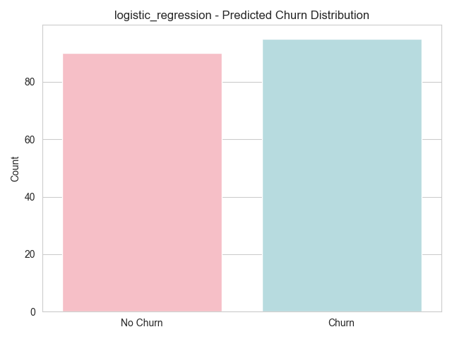
Model Evaluation Visualizations
2) LOGISTIC REGRESSION

Slide 13
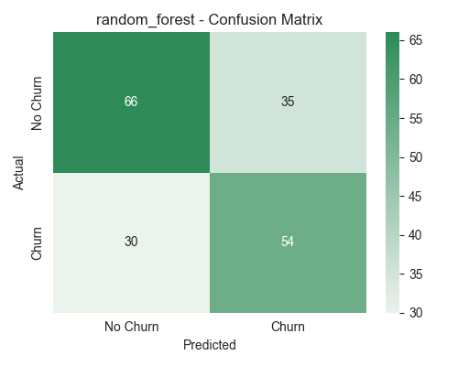
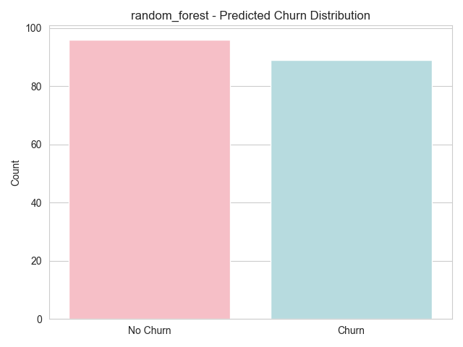
Model Evaluation Visualizations
2) RANDOM FOREST

Slide 14
Prediction on New Data
The trained models can be used to predict churn on new, unseen customer data.
Process
Sample Output
Load a sample of new test data.
Clean and preprocess the new data using the same pipeline.
Customer ID: 1001 --> Predicted Churn: 0 | Actual: 1 Customer ID: 1002 --> Predicted Churn: 1 | Actual: 1 Customer ID: 1005 --> Predicted Churn: 0 | Actual: 1 Customer ID: 1006 --> Predicted Churn: 0 | Actual: 0 Customer ID: 1007 --> Predicted Churn: 0 | Actual: 0 Customer ID: 1008 --> Predicted Churn: 1 | Actual: 0 Customer ID: 1009 --> Predicted Churn: 0 | Actual: 1
Apply one-hot encoding and feature scaling.
Load the trained Random Forest model.
Make predictions on the preprocessed test data.
Output predicted churn alongside actual churn for verification.

Slide 15


Key Takeaways & Next Steps
Comprehensive Pipeline
Actionable Insights
The project provides a robust framework for identifying potential churn risks.
Successfully built an end-to-end ML pipeline from data ingestion to model prediction.
Future Enhancements
Explore advanced models, hyperparameter tuning, and real-time prediction integration.

